Slide 1

SJSU Spring 2020 EE122 lab section #5 lab 8
Testing and Documenting CS amplifiers
Scopy software
TA: Wen Zhi Qian
Email: wenzhi.qian@sjsu.edu

Slide 2
Part A
threshold voltage for discrete MOSFETs measure the only one you have, not 10.

Slide 3
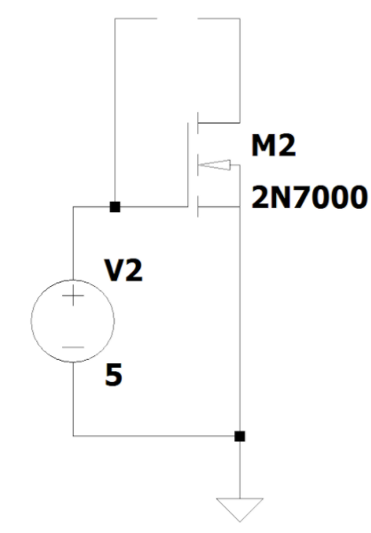
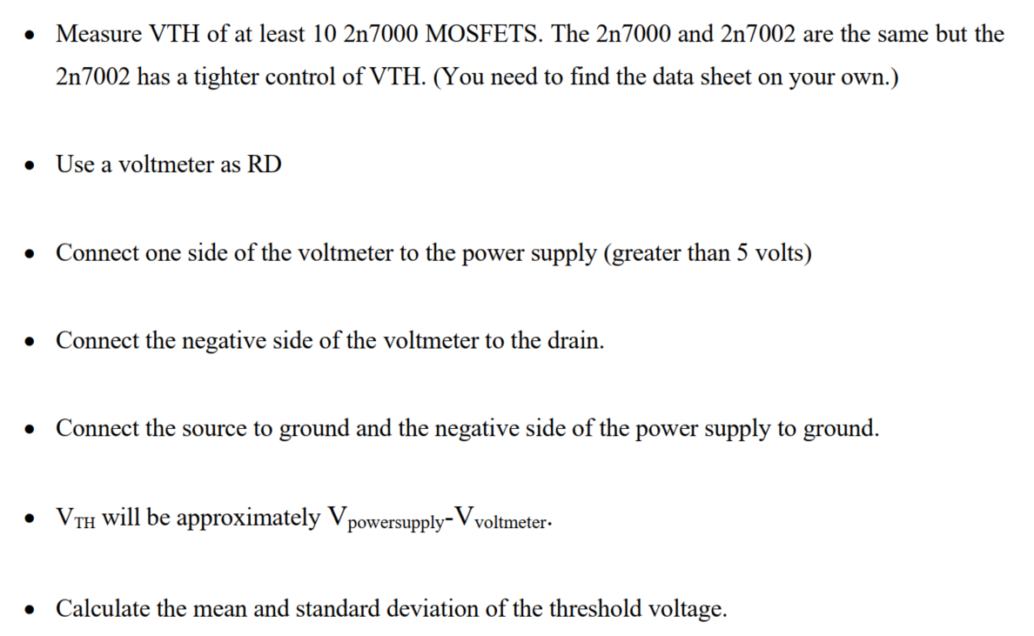
Original lab 8 circuit will not work
Voltage meter
Original circuit description
Please explain why this will not work in your report for lab8.

Slide 4
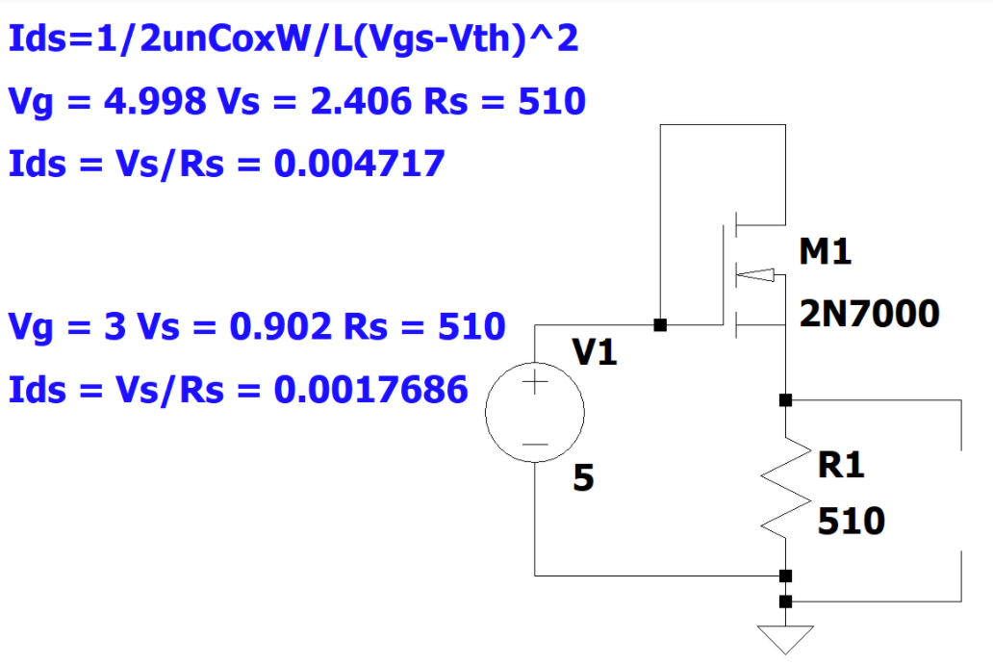
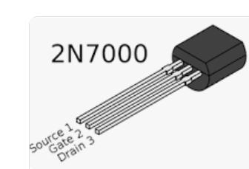
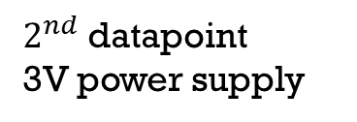
Modified circuit and a few measured parameters
Drain and gate are both connected to power supply
1st datapoint
5 V power supply
$2^{nd}$ datapoint
3V power supply
Voltage meter
You should have a wire to connect your gate and drain.

Slide 5
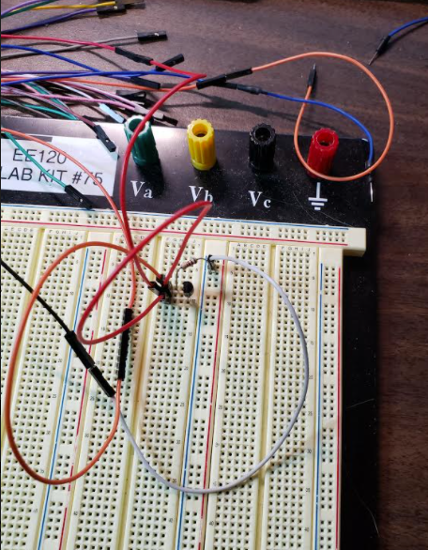
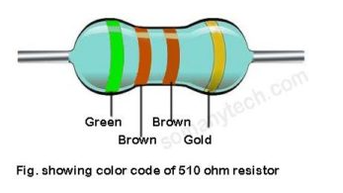
Physical configuration of the circuit

Slide 6
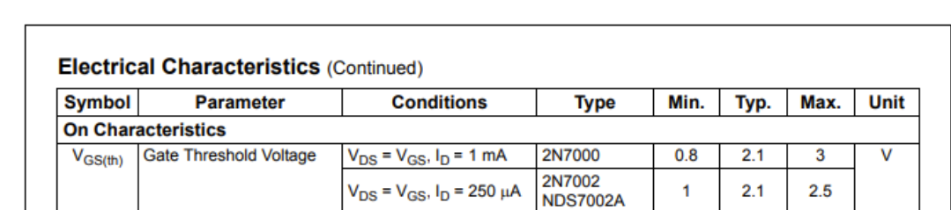

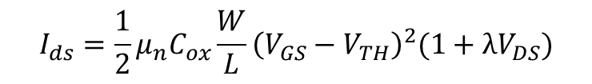




2N7000 datasheet
$$I_{ds}=\frac{1}{2}μ_{n}C_{ox}\frac{W}{L}{\left(V_{GS}−V_{TH}\right)}^{2}(1+λV_{DS})$$
$$\frac{I_{ds1}}{I_{ds2}}= \frac{{\left(V_{GS1}−V_{TH}\right)}^{2}}{{\left(V_{GS2}−V_{TH}\right)}^{2}}=\frac{0.004717}{0.0017686}=2.67$$
$$\frac{\left(V_{GS1}−V_{TH}\right)}{\left(V_{GS2}−V_{TH}\right)}=1.63$$
$$\frac{a−x}{b−x}=c$$
Could you think about this measured $V_{TH}$ is lower or higher than actual $V_{TH}$?
$x= \frac{a−bc}{1−c}$= $\frac{\left(4.998−2.406\right)−(3−0.902)∗1.63}{1−1.63}$=1.31= $V_{TH}$

Slide 7
Part B
Fabricate and test the two CS designs you did last week.
Take pictures of your physical circuit to put in your report

